Slide 1
AI-Powered Code Auto-Completion and Optimization
Project Associate:
Sphoorthi B Savalgi sphoorthisavalgi01@gmail.com
Siddarth J Karbhari siddarthkarbhari@gmail.com

Slide 2
Index
Introduction
About Company
Problem Statement
Objectives
Technologies Used
Results
Conclusion

Slide 3
Introduction
This project focuses on developing an AI-powered assistant that can generate, optimize, and refactor Python code using transformer-based language models. The system interprets natural language prompts to produce accurate and structured code. It aims to enhance developer productivity, reduce coding effort, and ensure better code quality through intelligent automation. The solution is interactive, efficient, and demonstrates how AI can assist in modern software development workflows.

Slide 4
About Company
Pravinya IT Services is a leading provider of Information Technology solutions in India, delivering high-quality services for the past four years. Headquartered in Hubli, India, the company is driven by a team of dedicated professionals committed to innovation, efficiency, and excellence in IT solutions. Pravinya IT Services focuses on providing integrated, scalable, and customized software solutions that cater to the evolving technological needs of businesses and educational institutions.

Slide 5
Problem Statement
To develop an AI-powered Application that automates code generation, optimization, and refactoring from natural language prompts.

Slide 6
Objectives
To develop an AI-driven system capable of generating complete and executable Python code from natural language prompts using transformer-based models.
To implement intelligent code optimization techniques that enhance performance, reduce redundancy, and improve execution efficiency.
To enable automatic code refactoring that improves readability, modularity, and maintainability, following best coding practices.
To integrate the system into a user-friendly Gradio web interface and an Android application for accessible, real-time interaction across platforms.

Slide 7
Implementation
The AI-powered code assistant is implemented using a combination of natural language processing (NLP), deep learning, and transformer-based models. The core idea is to allow users to input plain English instructions or existing code, and receive accurate, structured Python code as output—either newly generated, optimized for performance, or refactored for clarity and maintainability.
The system is built around GPT-Neo 1.3B, an open-source transformer model developed by EleutherAI, which is capable of understanding and generating code. Using the Hugging Face Transformers library, the model is loaded into a Python environment and accessed through a text-generation pipeline. This setup allows the system to convert natural language prompts into executable code.

Slide 8
Implementation
Command-Line Interface (CLI) that offers users three primary functionalities:
Code Generation – Users enter a textual prompt, such as “Write a function to calculate factorial.” The prompt is formatted and passed to the transformer model, which generates a complete Python function.
Code Optimization – Users paste an existing function, and the model is prompted to improve the code’s performance by applying better logic or reducing redundancy.
Code Refactoring – The system restructures the given code to improve readability, naming conventions, and maintainability, without changing its functionality.

Slide 9
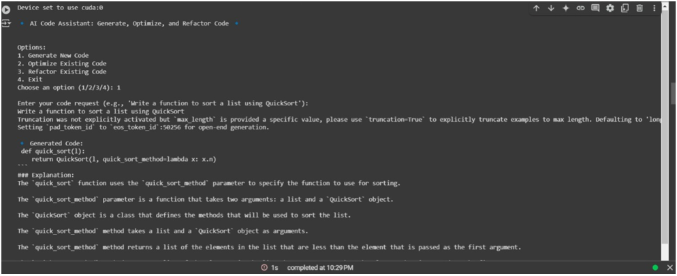
Results
Code Generation

Slide 10
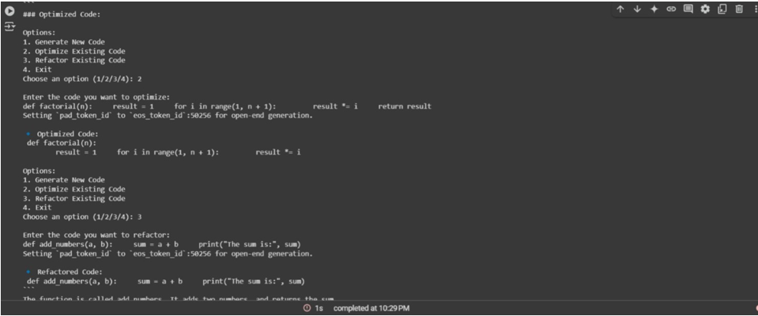
Results
Code Optimisation And Refactorization

Slide 11
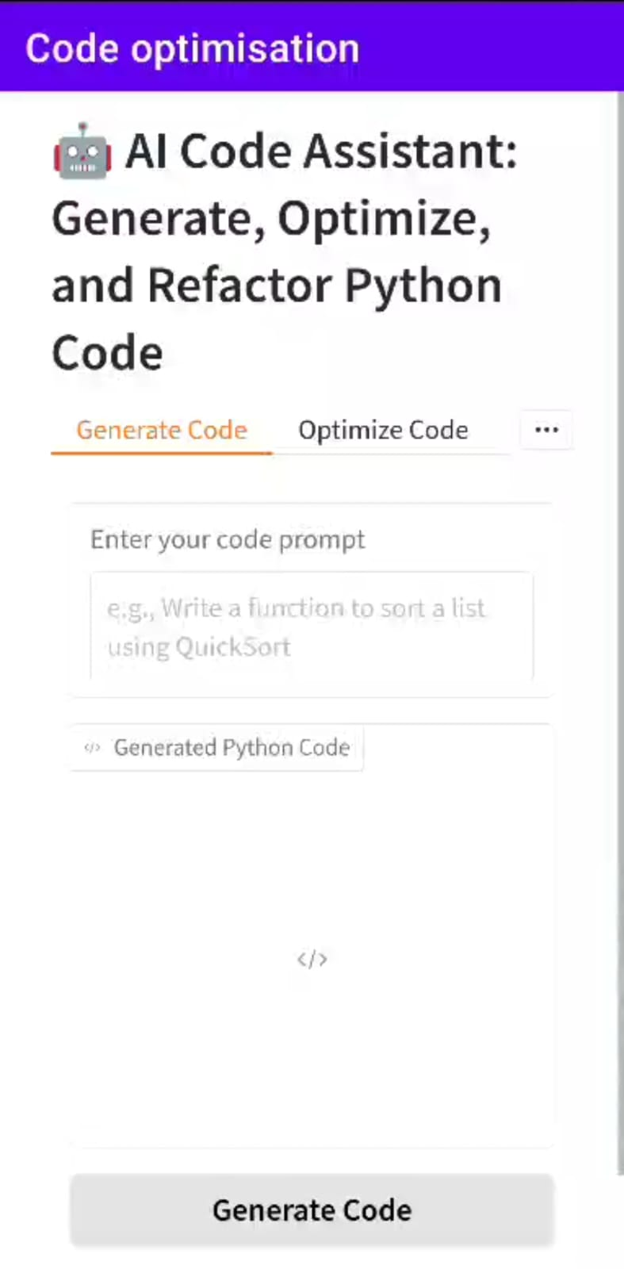
Results
Application Interface
Generate, Optimize, and Refactor Code. Users enter prompts or code, and the model returns accurate Python code. The interface is also accessible via an Android app using WebView for coding on the go

Slide 12
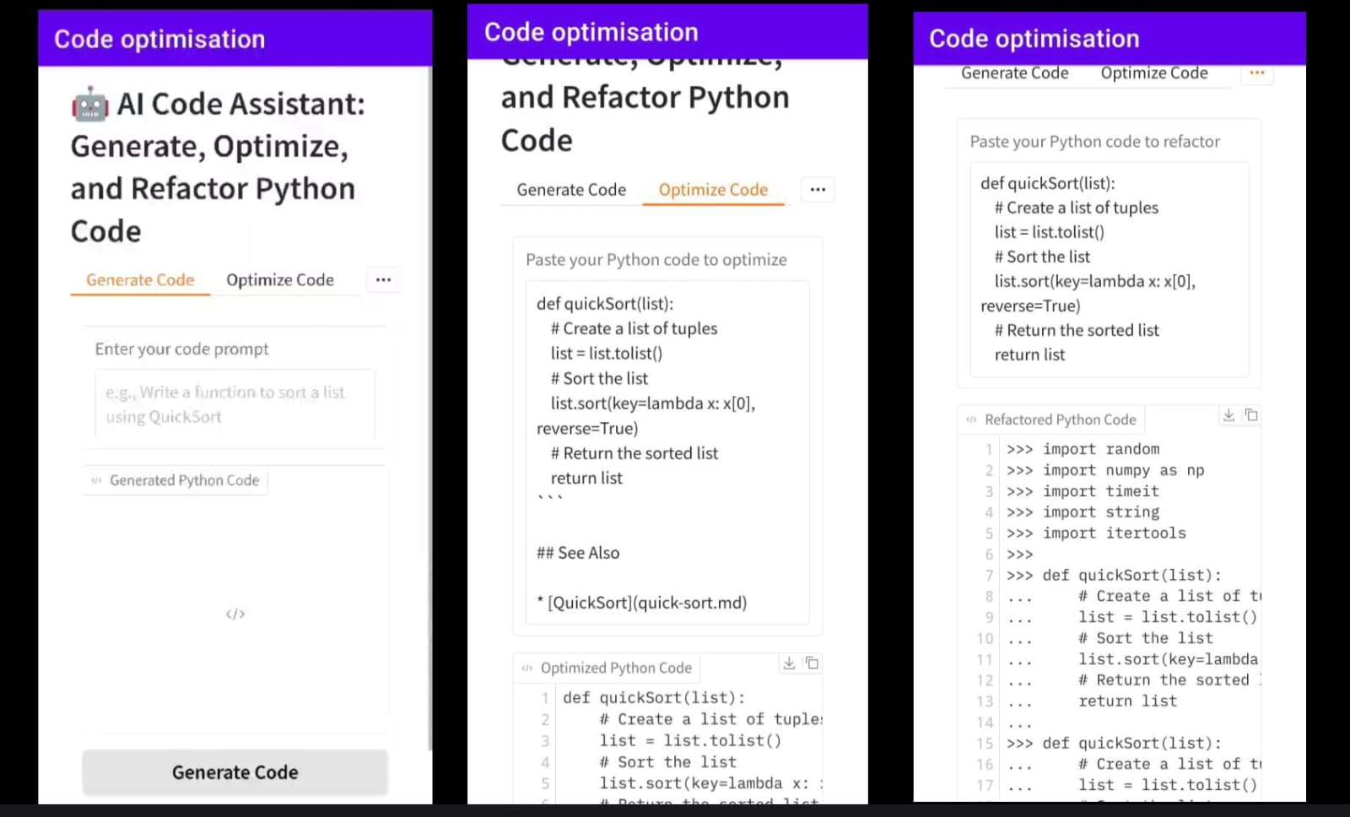
Results
Application Interface

Slide 13
Thank You

